Slide 1
Unsupervised Learning Algorithms
Noble Xavier

Slide 2
UNSUPERVISED LEARNING

Slide 3
Unsupervised Learning
Unsupervised learning is a type of machine learning that learns from unlabeled data. This means that the data does not have any pre-existing labels or categories. The goal of unsupervised learning is to discover patterns and relationships in the data without any explicit guidance.
Unsupervised learning allows the model to discover patterns and relationships in unlabeled data.
Clustering algorithms group similar data points based on their inherent characteristics.
Feature extraction captures essential information from the data, enabling the model to make meaningful distinctions.
Label association assigns categories to the clusters based on the extracted patterns and characteristics.

Slide 4
Advantages of Unsupervised Learning
It does not require training data to be labelled.
Dimensionality reduction can be easily accomplished using unsupervised learning.
Capable of finding previously unknown patterns in data.
Unsupervised learning can help you gain insights from unlabeled data that you might not have been able to get otherwise.
Unsupervised learning is good at finding patterns and relationships in data without being told what to look for. This can help you learn new things about your data.

Slide 5
Disadvantages of Unsupervised Learning
Difficult to measure accuracy or effectiveness due to lack of predefined answers during training.
The results often have lesser accuracy.
The user needs to interpret and label the classes that follow that classification.
Unsupervised learning can be sensitive to data quality, including missing values, outliers, and noisy data.
Without labelled data, evaluating the performance of unsupervised learning models can be difficult, making it challenging to assess their effectiveness.

Slide 6
Supervised Vs Unsupervised Learning
Parameters | Supervised machine learning | Unsupervised machine learning
Input Data | Algorithms are trained using labeled data. | Algorithms are used against data that is not labeled
Computational Complexity | Simpler method | Computationally complex
Accuracy | Highly accurate | Less accurate
No. of classes | No. of classes is known | No. of classes is not known
Data Analysis | Uses offline analysis | Uses real-time analysis of data
Algorithms used | Linear and Logistics regression, Random forest, multi-class classification, decision tree, Support Vector Machine, Neural Network, etc. | K-Means clustering, Hierarchical clustering, KNN, Apriori algorithm, etc.

Slide 7
Supervised Vs Unsupervised Learning
Parameters | Supervised machine learning | Unsupervised machine learning
Output | Desired output is given. | Desired output is not given.
Training data | Use training data to infer model. | No training data is used.
Complex model | It is not possible to learn larger and more complex models than with supervised learning. | It is possible to learn larger and more complex models with unsupervised learning.
Model | We can test our model. | We can not test our model.
Called as | Supervised learning is also called classification. | Unsupervised learning is also called clustering.
Example | Example: Optical character recognition. | Example: Find a face in an image.
Supervision | supervised learning needs supervision to train the model. | Unsupervised learning does not need any supervision to train the model.

Slide 8
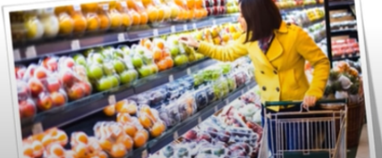

Examples Clustering
Items Arranged in a Mall
Group of Diners in a Restaurant

Slide 9
Types Of Clustering
Exclusive Clustering: An exclusive classification is a partition of the set of objects where each object belongs to exactly one cluster.
Overlapping Clustering: Overlapping clustering methods allow data points to belong to more than one cluster. Partitioning methods are a popular type of overlapping clustering algorithm because they are simple and effective for large datasets.
Hierarchical Clustering: Hierarchical clustering, also known as hierarchical cluster analysis, is an algorithm that groups similar objects into groups called clusters.

Slide 10
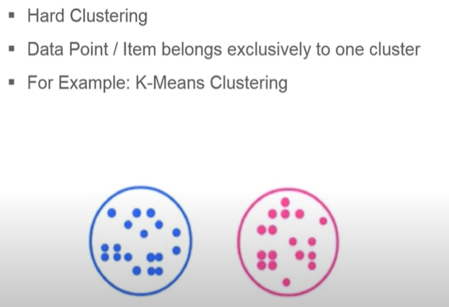
Exclusive Clustering

Slide 11
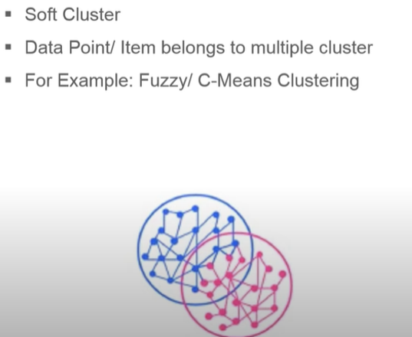
Overlapping Clustering

Slide 12
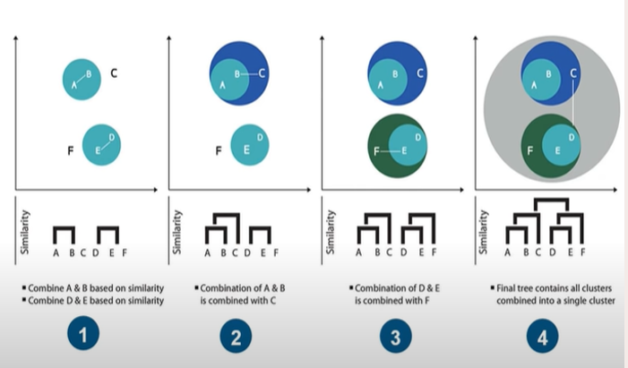
Hierarchical Clustering

Slide 13
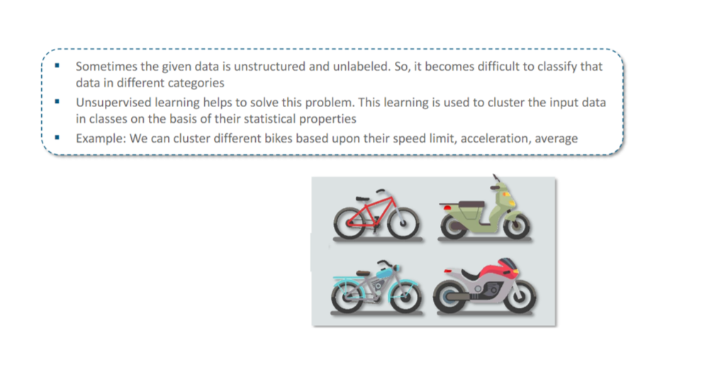
Unsupervised Learning

Slide 14
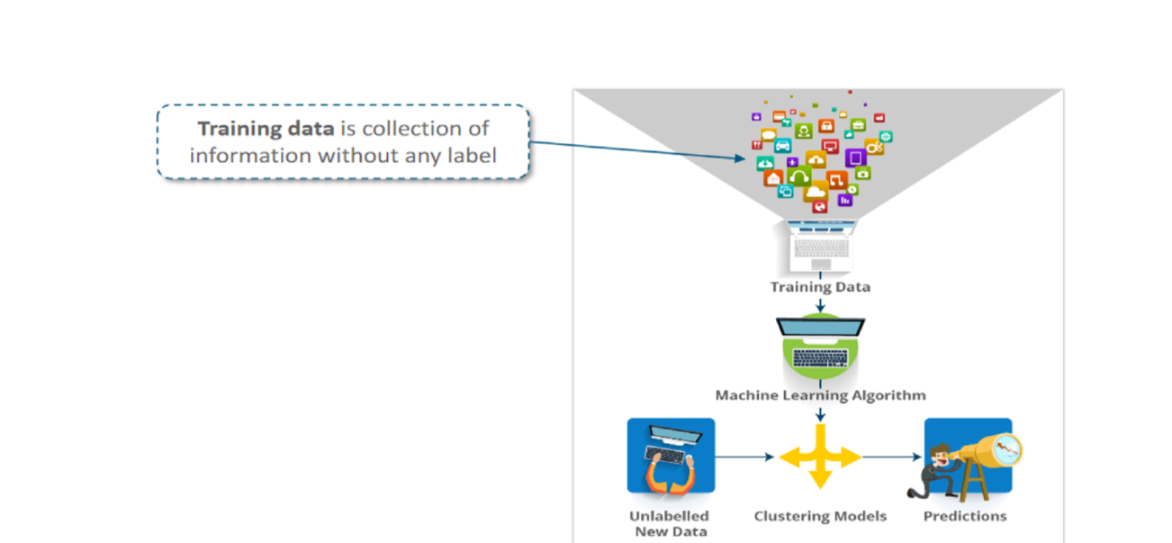
Unsupervised Learning

Slide 15
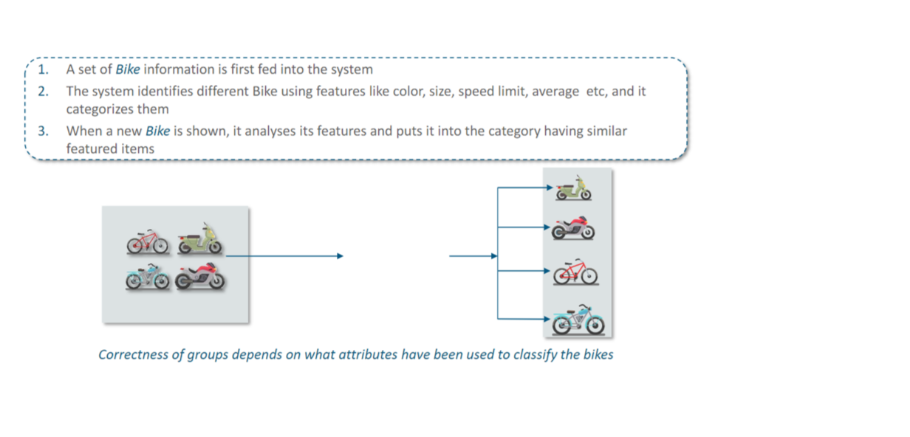
Unsupervised Learning-Example

Slide 16
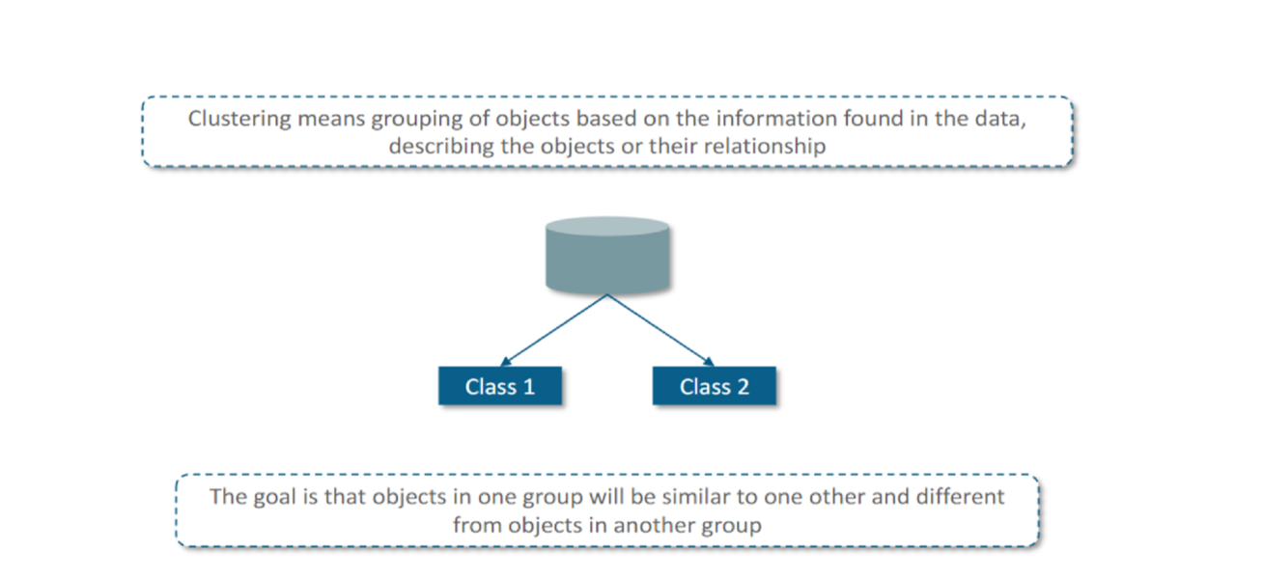
Clustering

Slide 17
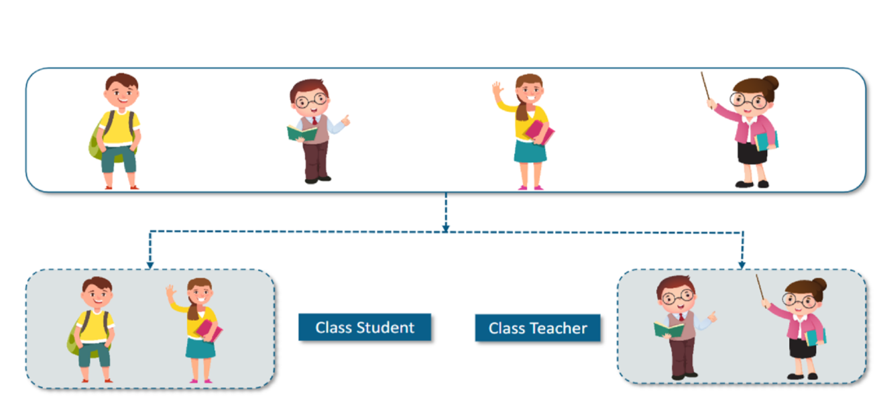
Clustering

Slide 18
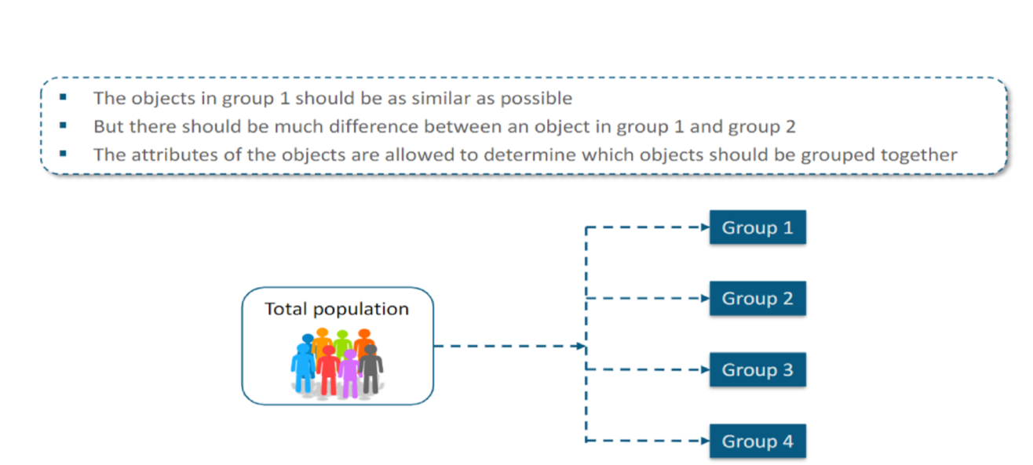
Clustering

Slide 19
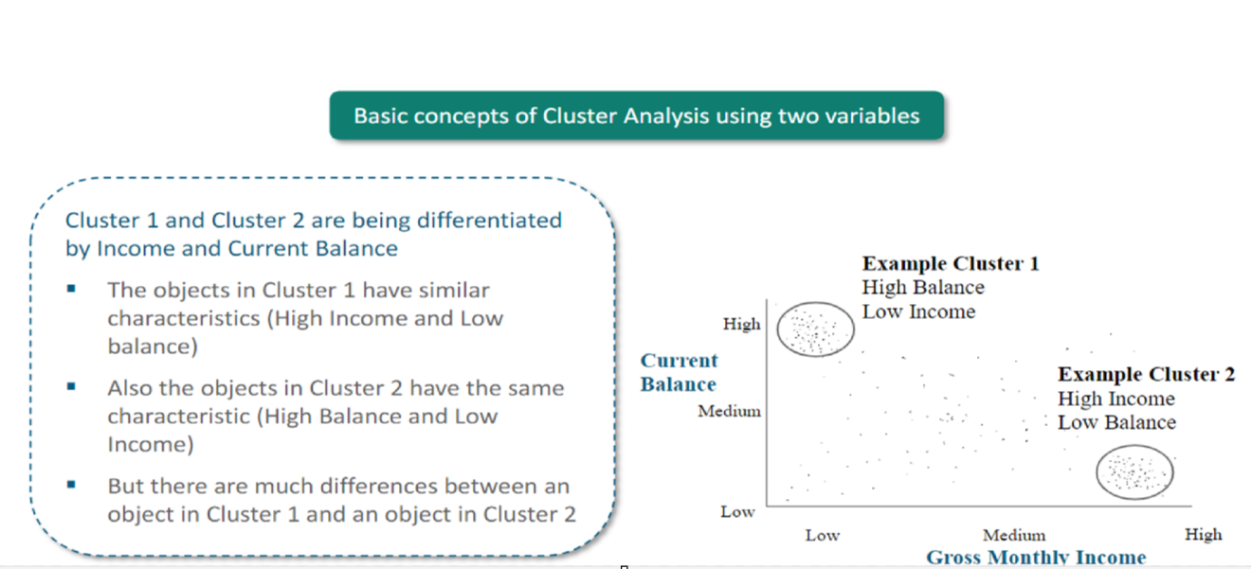
Clustering

Slide 20
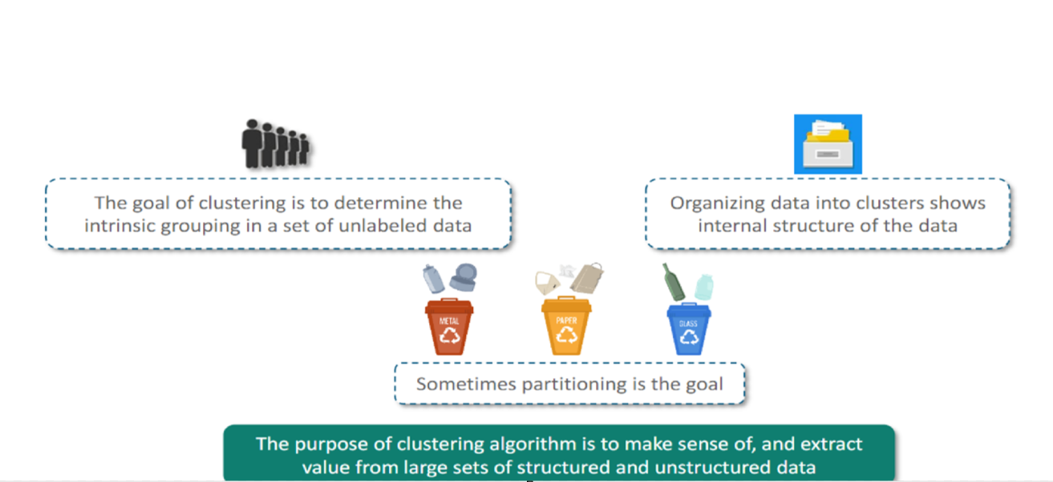
Clustering

Slide 21
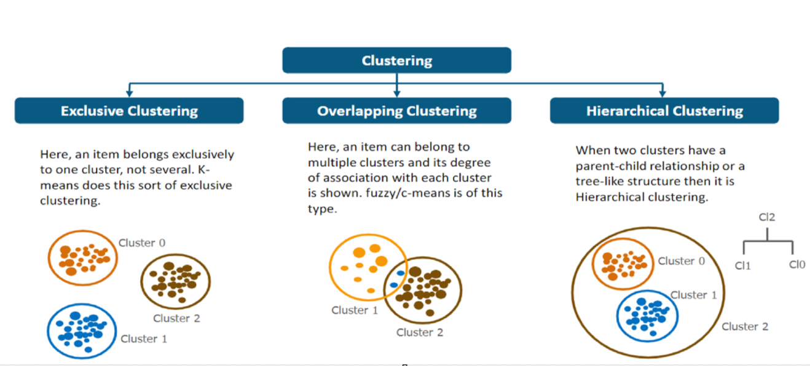
Classification of Clustering

Slide 22
K-MEANS CLUSTERING

Slide 23
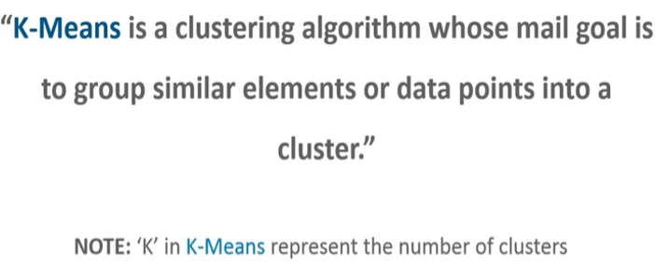
K-Means Clustering
K-means clustering is a popular unsupervised machine learning algorithm used for partitioning a dataset into a pre-defined number of clusters. The goal is to group similar data points together and discover underlying patterns or structures within the data.

Slide 24
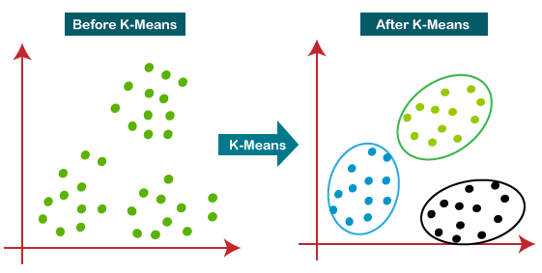
K-Means Clustering
The below diagram explains the working of the K-means Clustering Algorithm:

Slide 25
Working of K-Means Clustering
The working of the K-Means algorithm is explained in the below steps:
Step 1: Select the number K to decide the number of clusters.
Step 2: Select random K points or centroids. (It can be other than the input dataset).
Step 3: Assign each data point to its closest centroid, which will form the predefined K clusters.
Step 4: Calculate the variance and place a new centroid of each cluster.
Step-5: Repeat the third step, which means reassigning each datapoint to the new closest centroid of each cluster.
Step-6: If any reassignment occurs, then go to step-4 else go to FINISH.
Step-7: The model is ready.

Slide 26
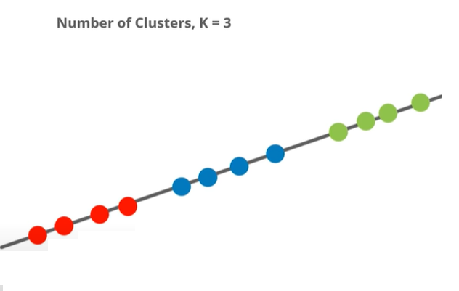
K-Means Clustering
Data is arranged with in three clusters

Slide 27
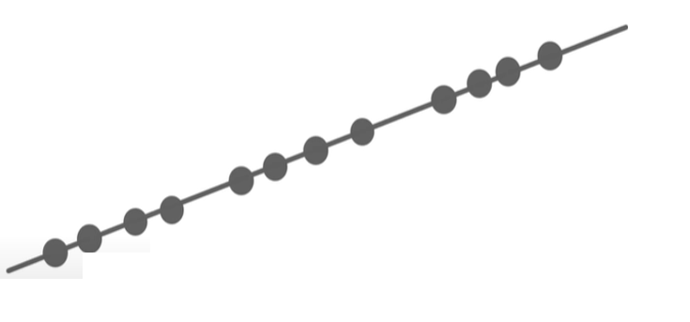
K-Means Clustering
Data set without cluster

Slide 28
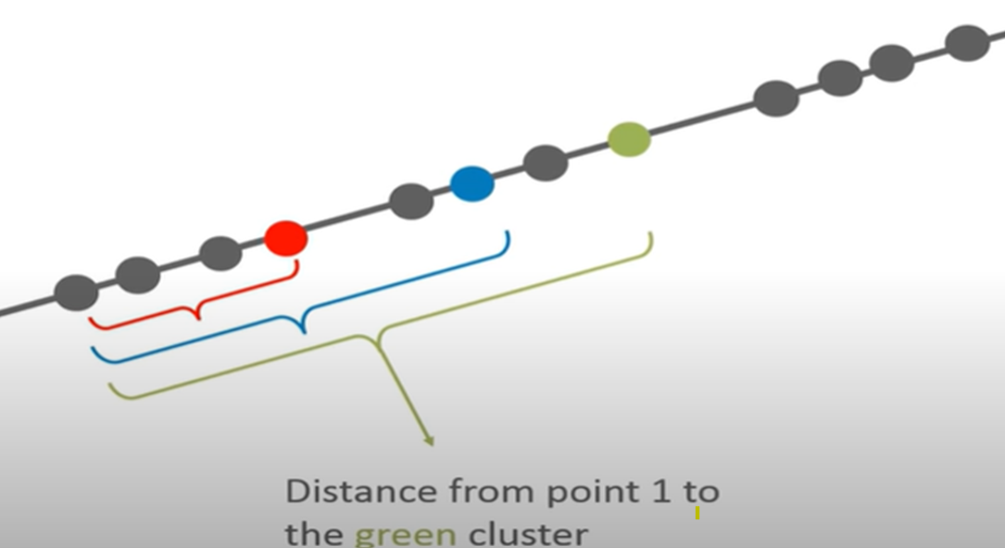
K-Means Clustering
Step 1: Select the number of Clusters to be identified (Select a value for k =3 in this case)
Step 2: Randomly select 3 distinct data points.
Step 3: Measure the distance between the 1st point and selected 3 clusters.

Slide 29
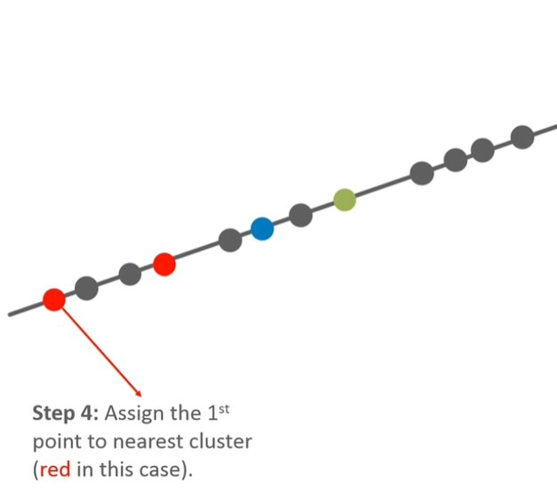
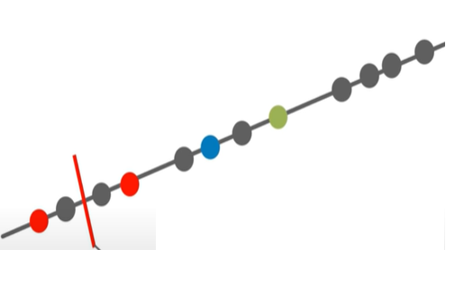
K-Means Clustering
Step 5: Calculate the Mean value including the new point for the red cluster

Slide 30
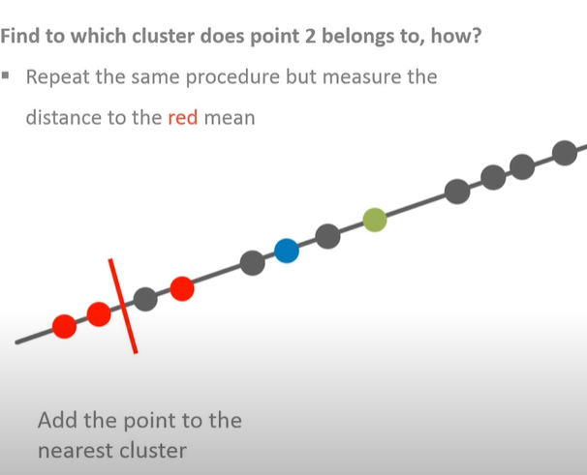
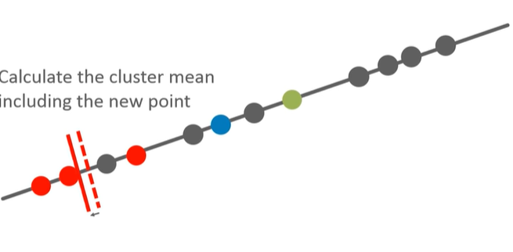
K-Means Clustering

Slide 31
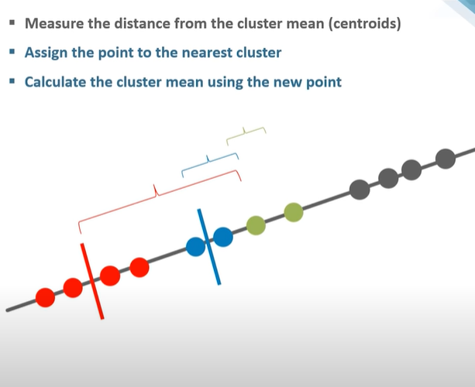
K-Means Clustering

Slide 32
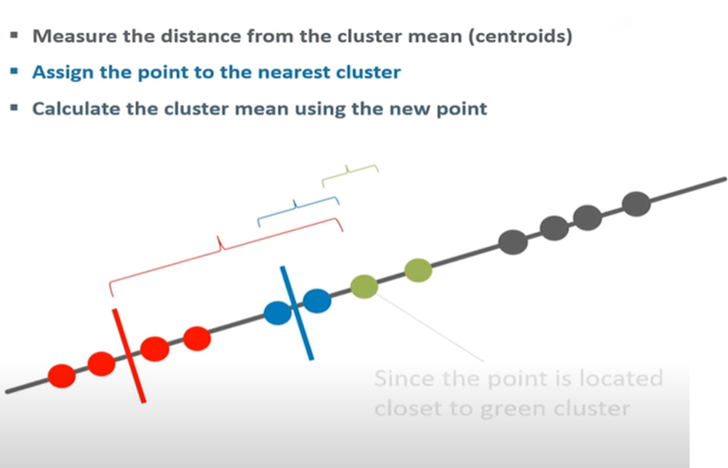
K-Means Clustering

Slide 33
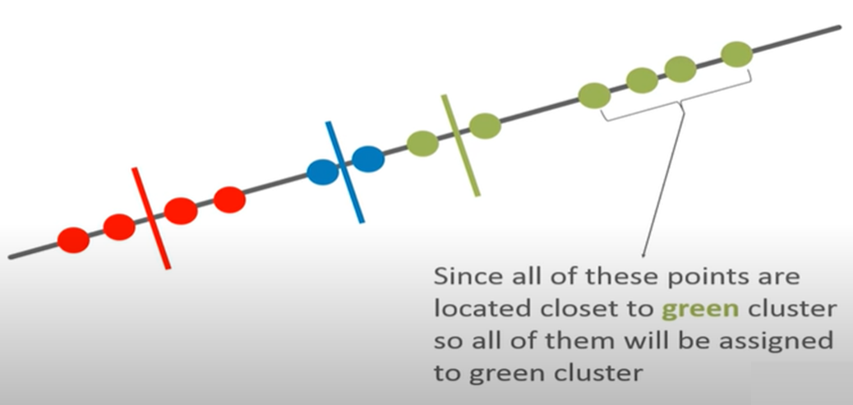
K-Means Clustering

Slide 34
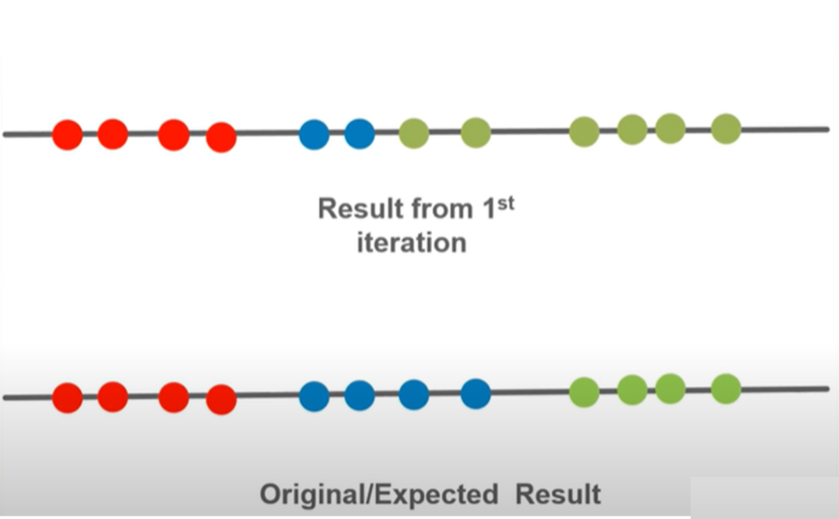
K-Means Clustering

Slide 35
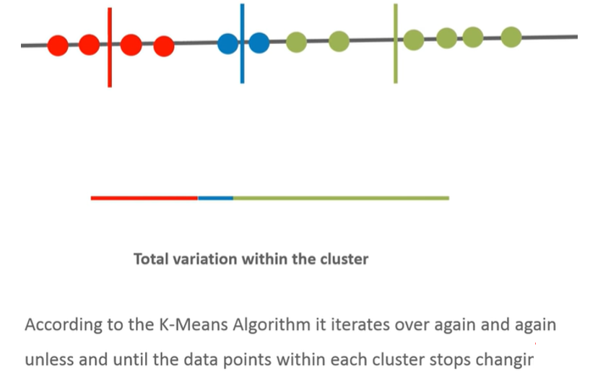
K-Means Clustering

Slide 36
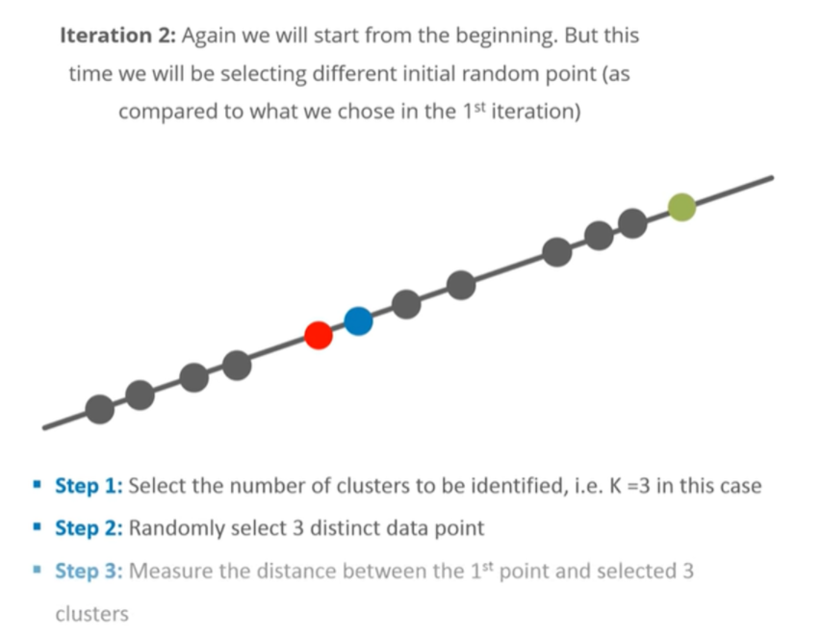
K-Means Clustering

Slide 37
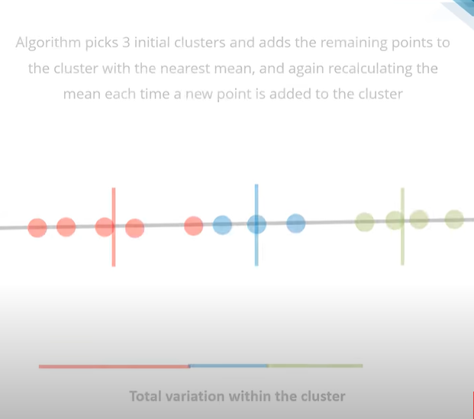
K-Means Clustering

Slide 38
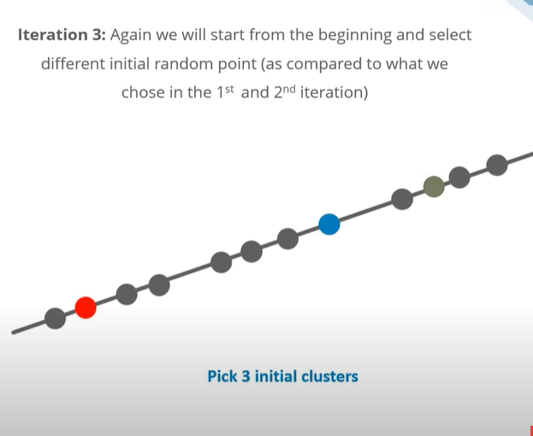
K-Means Clustering

Slide 39
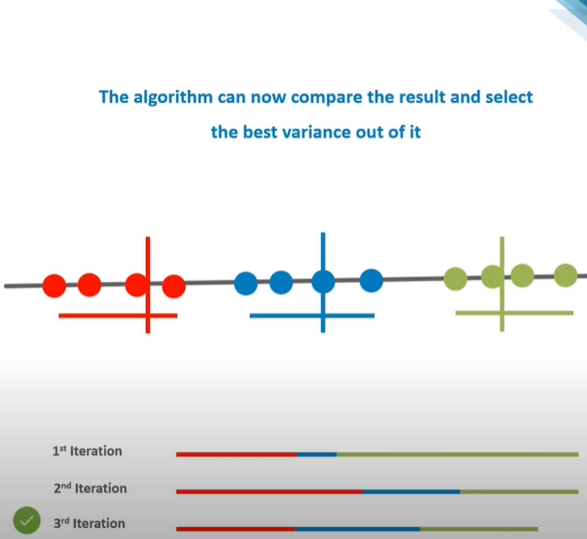
K-Means Clustering

Slide 40
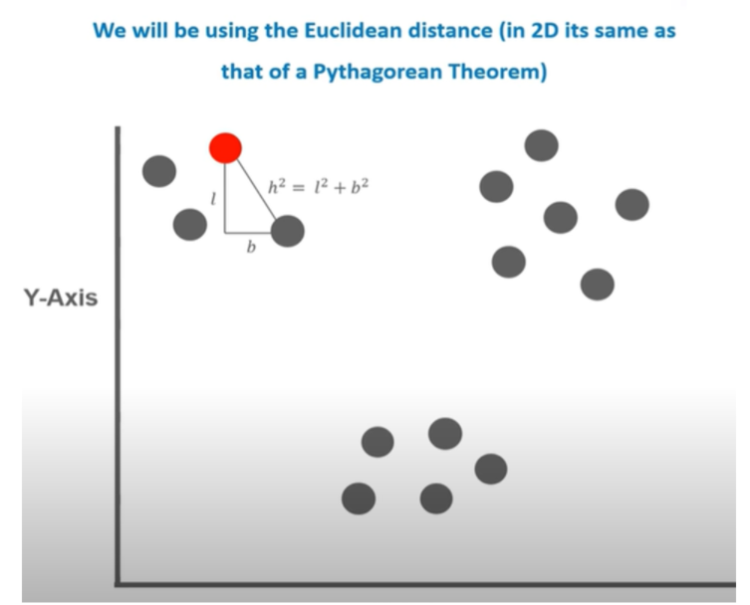
K-Means Clustering- in 2D Data

Slide 41
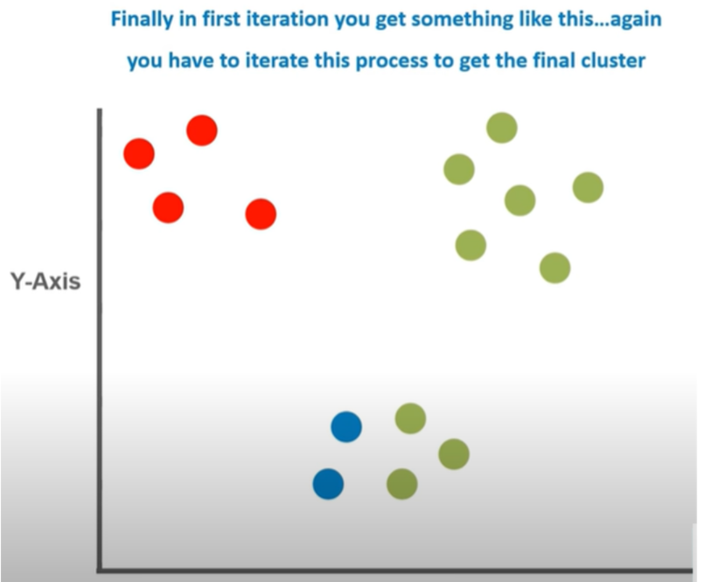
K-Means Clustering

Slide 42
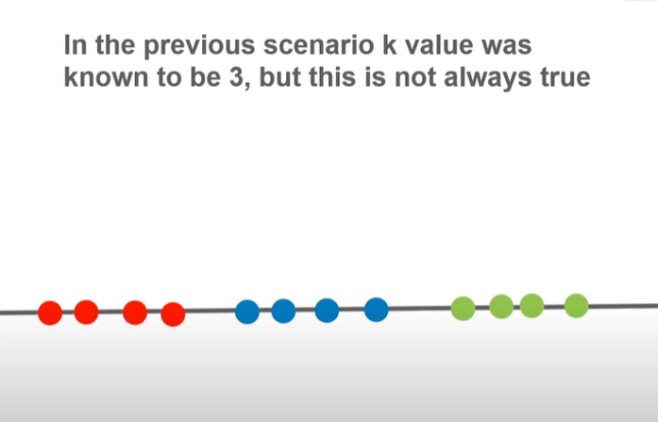
Find K Value

Slide 43
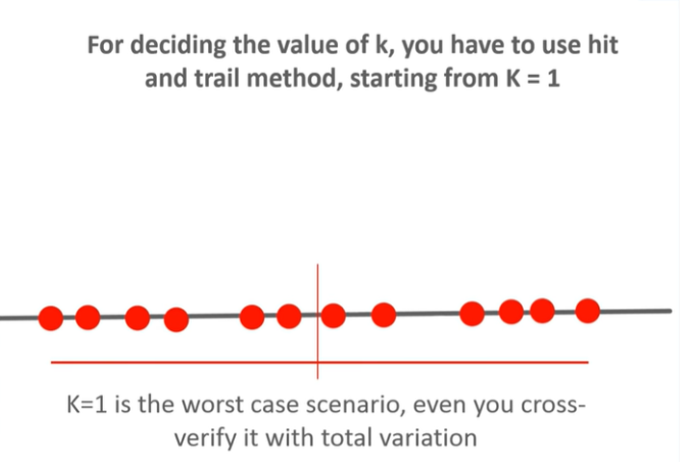
Find K Value

Slide 44
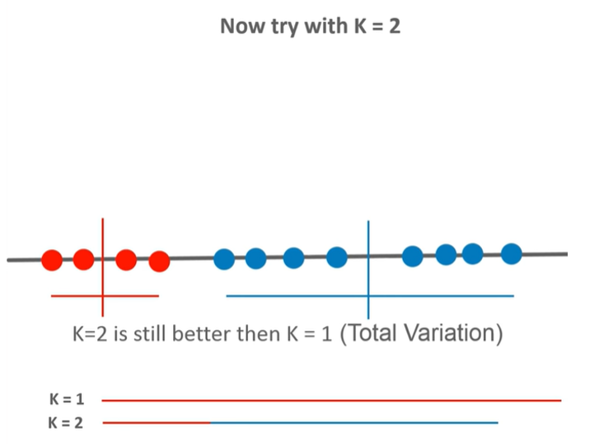
Find K Value

Slide 45
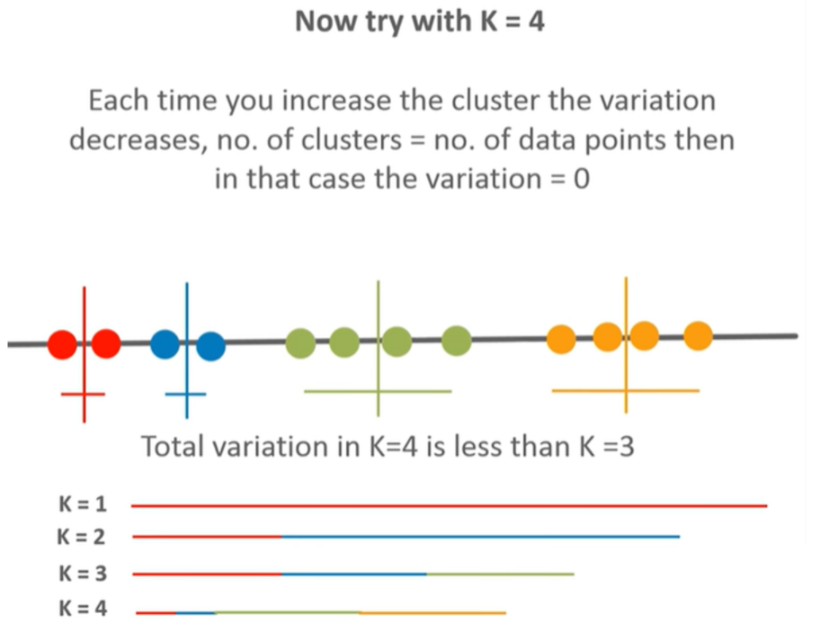
Find K Value

Slide 46
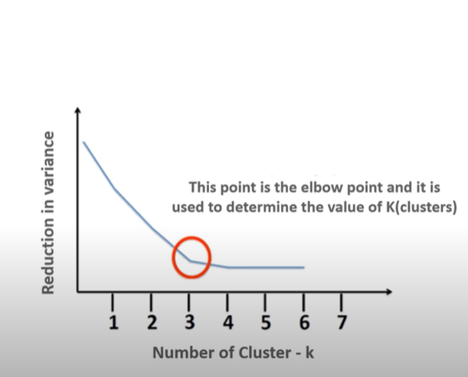
Find K Value-Elbow Graph

Slide 47
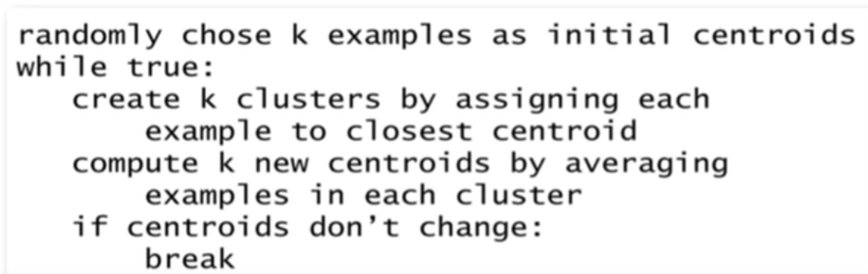
Summarising the K-Means Algorithm

Slide 48
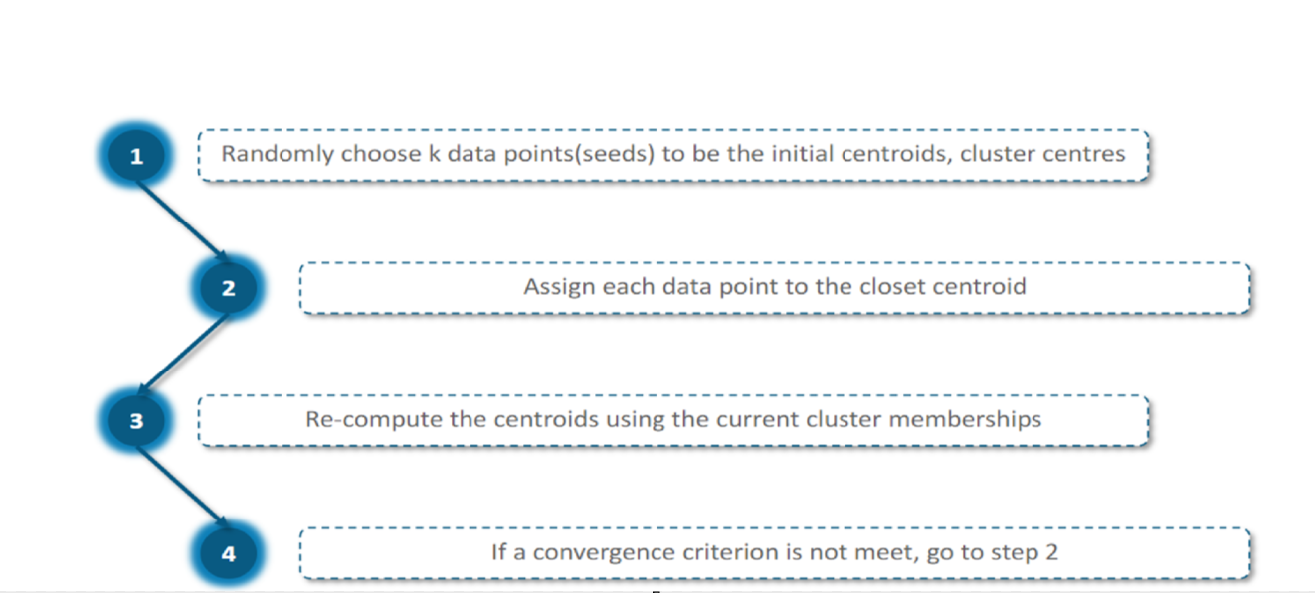
K-Means Algorithm

Slide 49
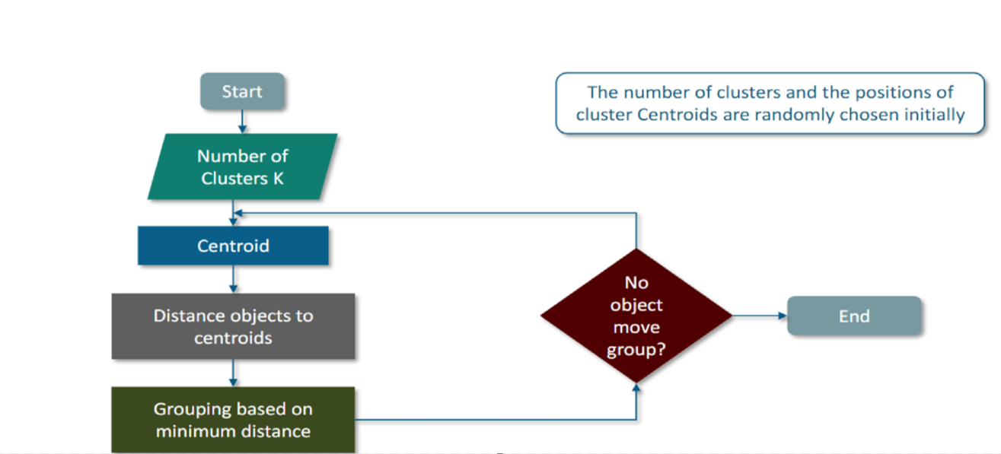
K-Means Flow Chart

Slide 50
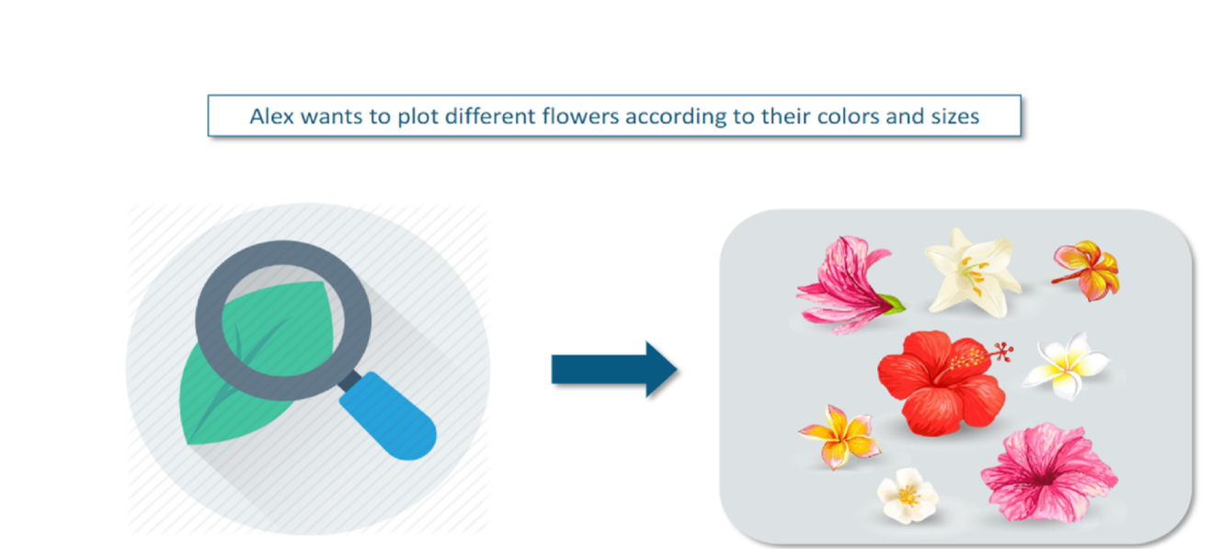
K-Means Example

Slide 51
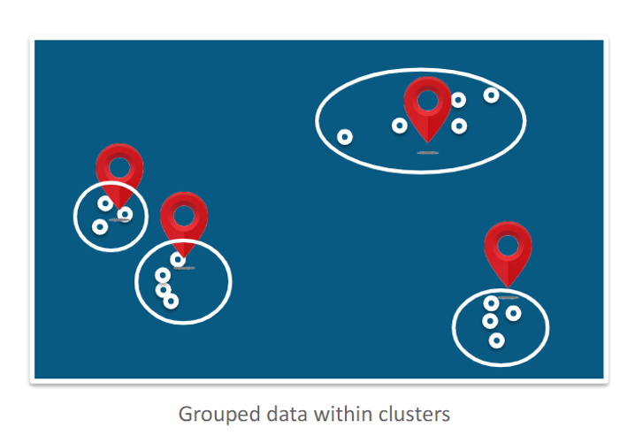
K-Means Solution

Slide 52
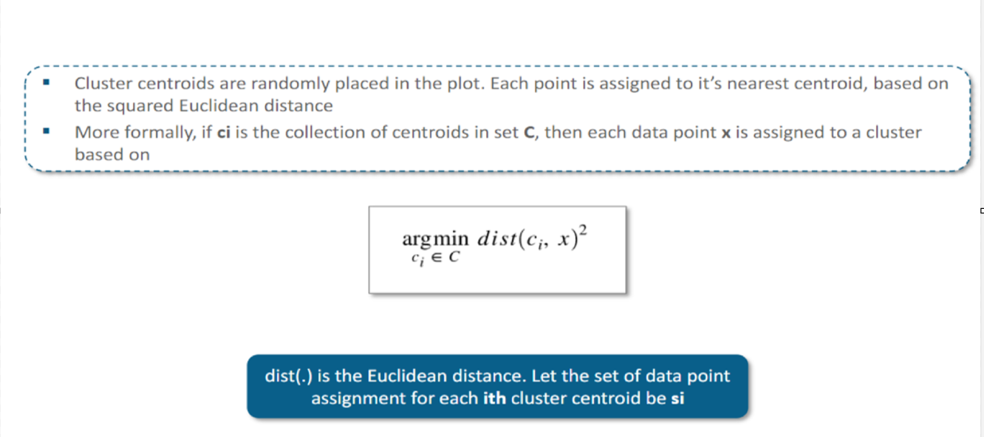
K-Means Solution-Step 1 – Data Assignment

Slide 53
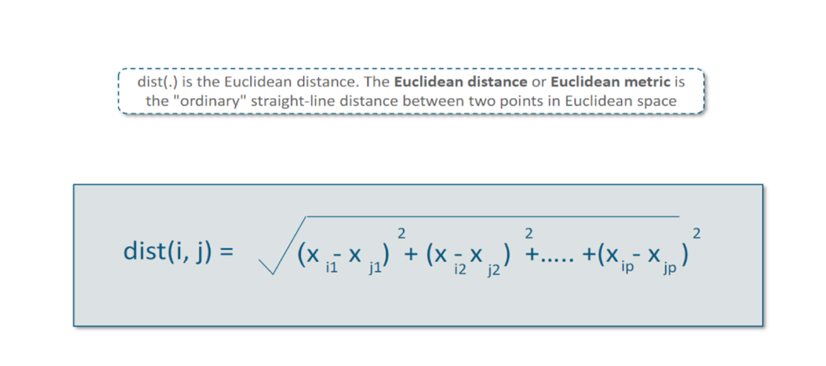
K-Means Solution-Step 1 – Euclidean Distance

Slide 54
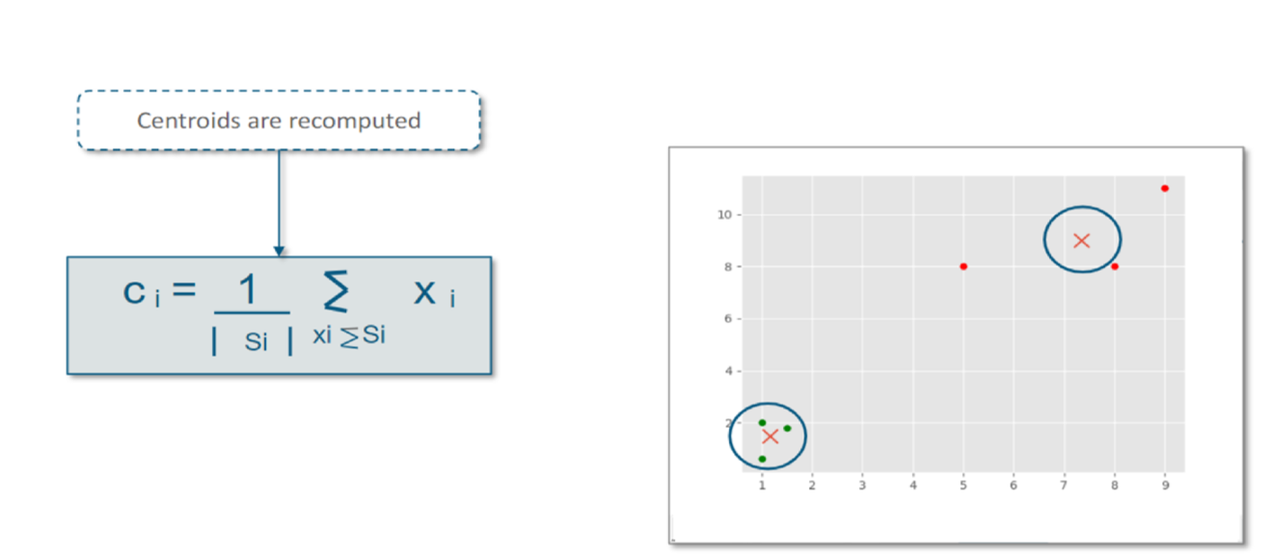
K-Means Solution-Step 2 – Centroid Update

Slide 55
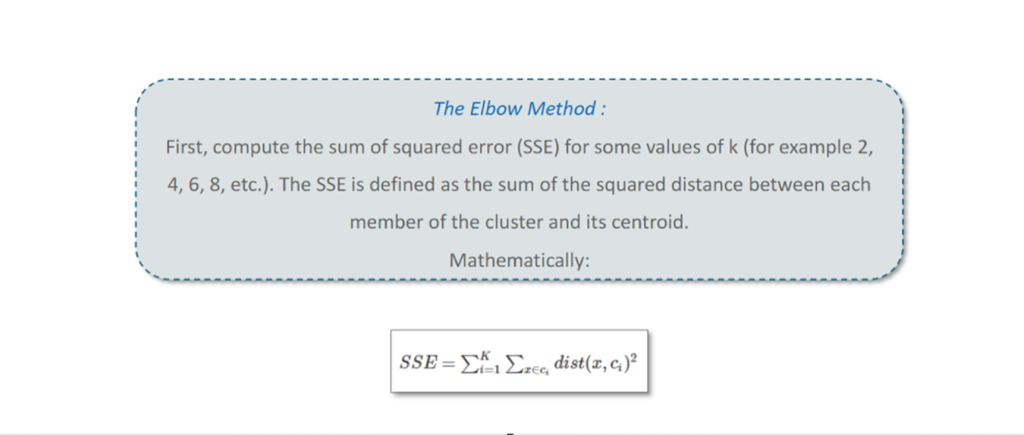
Elbow Method to Decide Number of Clusters

Slide 56
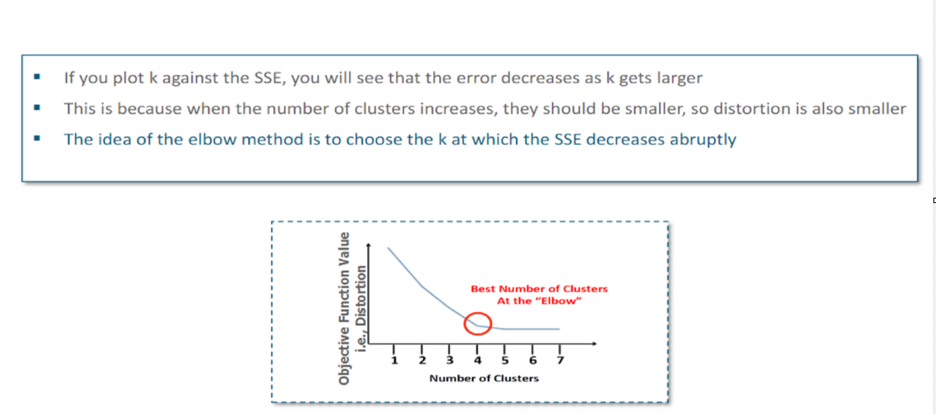
Elbow Method to Decide Number of Clusters

Slide 57
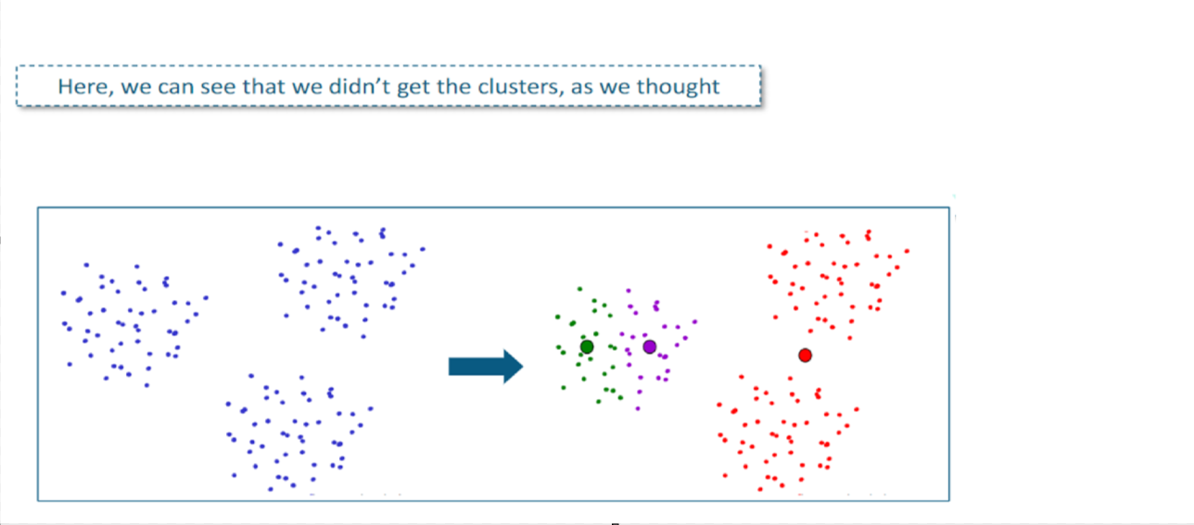
Find Optimal Solution

Slide 58
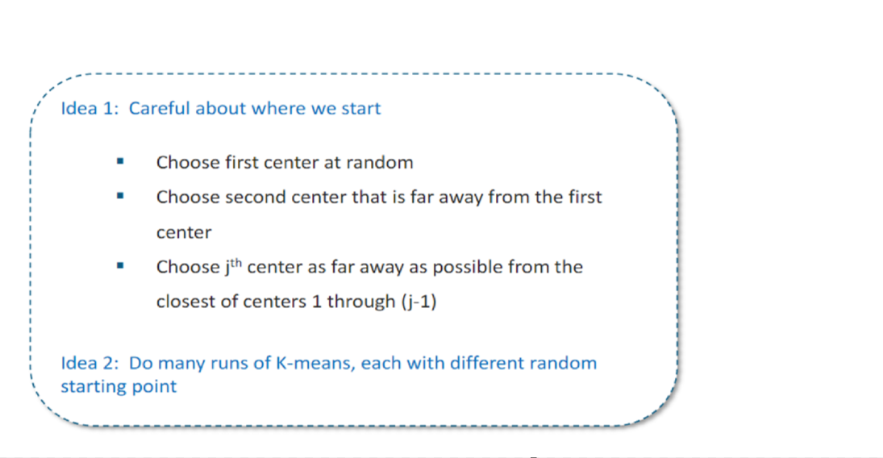
Find Optimal Solution

Slide 59

K-Means Example

Slide 60

Read the File and print Its Size

Slide 61


Slide 62


Slide 63


Slide 64


Slide 65


Slide 66


Slide 67


Slide 68


Slide 69

Soft Clustering Example: For chest pain, 60 % chance of heart attack 40 % chance of gastric

Slide 70


Slide 71


Slide 72


Slide 73


Slide 74


